Slide 1
http://www.vidyanidhi.com/
ketkiacharya.net@gmail.com
Ketki Acharya
From: SM VITA ATC of CDAC
9769201036
ketkiacharya.net@gmail.com

Slide 2
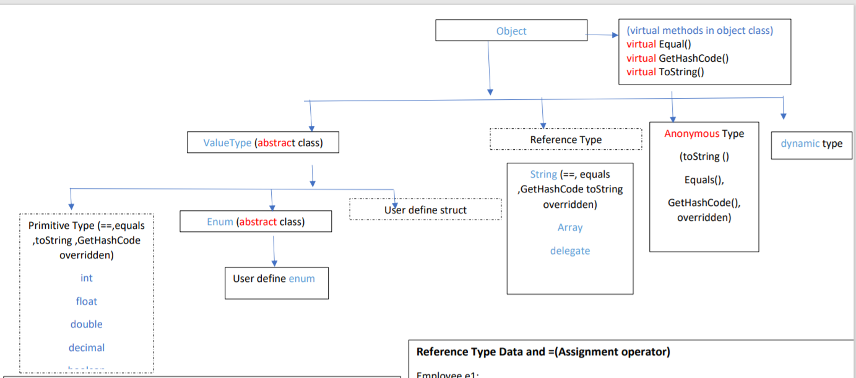
var

Slide 3
Can I print object directly
Here when you print object , internally it is calling ToString() method of your class Person.
But you do not have ToString method in Person class.
Who is the parent class of Person class?
Yes you are right Object.
So if child does not have that method then it looks in to parent class. Now if you have previous slide we know Object class has virtual string ToString() method who’s job is to return current class name ie person because we are calling a.ToString().
//implicitly calling ToString method
Console.WriteLine(a);
//Explicitly calling Tostring method. Console.WriteLine(a.ToString());
is :It is operator which says “a” is instance of class person. It returns Boolean value
using System; using System.Text;
namespace ObjectOverrides
{ // Remember! Person extends Object.
class Person :Object
{
string fnm, lnm;
int age;
public Person(string fName, string lName, int personAge)
{
fnm = fName;
lnm = lName;
age = personAge;
}
}
class program
{
static void Main()
{ Person a = new Person("Raj", "Mathur", 22);
Person b = new Person("Geeta", "Shah", 22);
Console.WriteLine(a);
Console.WriteLine(a.ToString());
Console.WriteLine(a is Person);//true
Console.WriteLine(a is StringBuilder);//false
Console.WriteLine(a is Object);//true
}
}
} o/p: ObjectOverrides.Person
ObjectOverrides.Person

Slide 4
Only virtual method can be overridden by child class
using System;
namespace ObjectOverrides
{
// Remember! Person extends Object.
class Person
{
string fnm, lnm;
int age;
public Person(string fName, string lName, int personAge)
{
fnm = fName;
lnm = lName;
age = personAge;
}
public override string ToString()
{
return fnm + " " + lnm + " " + age;
}
}
class program
{
static void Main()
{
Person a = new Person("Raj", "Mathur", 22);
Person b = new Person("Geeta", "Shah", 20);
Console.WriteLine(a);
}
o/p Raj Mathur 22
}
}
In this example
Who is the parent class of person?
Ans: Object
You can override only ________method of parent class.
Ans: virtual
To override parent virtual method child class use ________ key word
Ans: Override
By default all method in c# are
Ans: sealed ie. Child class can not override.
List all the virtual methods in object class.
Public virtual string ToString(),
public int GetHashCode()
public bool Equals()

Slide 5
GetHashCode, ReferenceEquals, Equals
----ReferencEquals()---:it is a static method that tests two reference (Arrow )are same or not.you can not override this method;
Person a = new Person("Raj", "Mathur", 22);
Person b = new Person("Geeta", "Shah", 22);
Console.WriteLine(Object.ReferenceEquals(a,b));
Ans:False
Note:
if you try reference equals() for value type it will always give false as it will be boxed into object type.
referenceEquals(v,v) where v is variable of some value type will give you always false
Virtual Equals:This also check reference equality,How ever this method is virtual you can override it. if you override virtual equals you should override virtual GetHasCode() method other wise when you use dictinary class you will not get expected result as it use hashcode intalnally.
using System;
namespace ObjectOverrides
{ // Remember! Person extends Object.
class Person
{ string fnm, lnm;
int age;
public Person(string fName, string lName, int personAge)
{ fnm = fName;
lnm = lName;
age = personAge;
}
public override string ToString()
{
return fnm + " " + lnm + " " + age;
}
}
class program
{ static void Main()
{ Person a = new Person("Raj", "Mathur", 22);
Person b = new Person("Geeta", "Shah", 22);
Console.WriteLine(a);
Console.WriteLine(Object.ReferenceEquals(a,b)); //false Console.WriteLine(a.GetHashCode());
Console.WriteLine(b.GetHashCode());
Console.WriteLine(a.Equals(b));//false
}
}
}
GetHashCode
GetHashCode
Raj
Mathur
22
a
Raj
Mathur
22
a
20000
20000
b
b
Geeta
Shah
22
Geeta
Shah
22
30000
30000

Slide 6
if you try reference equals() for value type it will always give false as it will be boxed into object type.
referenceEquals(v,v) where v is variable of some value type will give you always false
int p, q;
p = 5;
q = 5;
Console.WriteLine(Object.ReferenceEquals(p, q));
(Object)a
stack
p
p
HEAP
5
2000
5
q
p
2000
5
4000
5
4000

Slide 7
Static Equals, ==
---static Equals(a,b) ---:(a and b is object) it is same as vitual Equals except it is static and take two argument. Advantage of this method is that it is able to cope when either of the objects is null. static overload 1st check whether the references it has been passed are null. If both are null it will return true else false.
if both the reference refer to something it calls the virtual instance version of Equals().
This method is able to cope when either of the objects is null , and, therefore, provides an extra safeguard against throwing exceptions if there is a risk that an object might be null .
[ie. when I use a.Equals(b) if one of the object is null it will throw System.NullReferenceException: Object reference not set to an instance of an object.]
== this also check two references only. This is overridden in string class so it check value and not reference.
So what we under stood is all following method checks reference
Equals
==
ReferenceEquals
In th previous example add following code and see out put
Console.WriteLine(Object.Equals(a, b)); //false
Console.WriteLine(a== b);//false
Note: In string class Equals, GethasCode and ToString are overridden.

Slide 8
using System;
namespace ObjectOverrides
{ // Remember! Person extends Object.
class Person
{
string fnm, lnm;
int age;
public Person(string fName, string lName, int personAge)
{
fnm = fName;
lnm = lName;
age = personAge;
}
public override string ToString()
{
return fnm + " " + lnm + " " + age;
}
}
class program
{
static void Main()
{
Person a = new Person("Raj", "Mathur", 22);
Person b = new Person("Geeta", "Shah", 22);
a = b;
Console.WriteLine(a == b);//true
Console.WriteLine(Object.Equals(a, b));//true
Console.WriteLine(a.Equals(b));//true
Console.WriteLine(Object.ReferenceEquals(a, b));//true
Console.WriteLine(a.GetHashCode() == b.GetHashCode());//true
}
}
}
GetHashCode
a
Raj
Mathur
22
20000
b
Geeta
Shah
22
30000
a = b; after this line diagram will change
We have to say b tu ja a me
This object will go for GC [Anath no one pointing to this data]
GetHashCode
a
Raj
Mathur
22
20000
b
Geeta
Shah
22
30000
b is holding arrow same arrow get copied in to a.
So all methods results into true [Equals == etc in code]
Recollect we have done shallow copy examples

Slide 9
Person p1 = new Person("Raj", "Mathur", 22);
Person p2 = new Person(“Raj", “Mathur", 22);
Suppose I have created two object with same data now if we use Equal, == ReferenceEqual all will give result false because p1 and p2 pointing to two different memory block[object]
But now I want my application to treat this object to be equal means Equal method should return true. To do this we have to override Equals method. As per rule if you override Equlas you must override GethashCode.
Why to override GethashCode.?
if you are building a custom type that you intend to store in a Hashtable type (within the System.Collections namespace), you should always override this member, as the Hashtable will be internally invoking Equals() and GetHashCode() to retrieve the correct object
Lets see how to override Equals and GetHashCode in next slide

Slide 10
class Program
{
static void Main(string[] args)
{ // NOTE: We want these to be identical to test
// the Equals() and GetHashCode() methods.
Person p1 = new Person("Raj", "Mathur", 22);
Person p2 = new Person("Raj", "Mathur", 22);
// Get stringified version of objects.
Console.WriteLine("p1.ToString() = {0}", p1.ToString());
Console.WriteLine("p2.ToString() = {0}", p2.ToString());
// Test Overridden Equals()
Console.WriteLine("p1 = p2?: {0}", p1.Equals(p2));
// Test hash codes.
Console.WriteLine("{0}",p1.GetHashCode() == p2.GetHashCode());
Console.WriteLine();
// Change age of p2 and test again.
p2.Age = 45;
Console.WriteLine("p1.ToString() = {0}", p1.ToString());
Console.WriteLine("p2.ToString() = {0}", p2.ToString());
Console.WriteLine("p1 = p2?: {0}", p1.Equals(p2));
Console.WriteLine("S {0}", p1.GetHashCode() == p2.GetHashCode());
}
}
}
using System;
namespace ObjectOverrides
{// Remember! Person extends Object.
class Person
{
string fnm, lnm;
int age;
public Person(string fName, string lName, int personAge)
{
fnm = fName;
lnm = lName;
age = personAge;
}
public int Age
{
get { return age; }
set { age = value; }
}
public override string ToString()
{
return string.Format("{0} {1} {2}]",fnm, lnm, age);
}
public override bool Equals( object obj )
{
return obj.ToString() == this.ToString();
}
// Return a hash code based on the person's ToString() value.
public override int GetHashCode()
{
return this.ToString().GetHashCode();
}
}

Slide 11
p1.Equals(p2)
public override bool Equals( object obj )
{ “Raj Mathur 22” “Raj Mathur 22”
return obj.ToString() == this.ToString();
}
So here we are calling to string method and since == operator is overloaded in string class we are taking advantage of it.
P2 tu ja obj may.
But obj is of a type Object class and p2 is of a type person class it works because Object is parent of Person class.
Note: Parent class reference can point to child class object.
Raj
Mathur
22
p1
obj
Raj
Mathur
22
p2

Slide 12
public override bool Equals( object obj )
{
if (obj is Person && obj != null)
{
Person temp;
temp = (Person)obj;
if (temp.fnm == this.fnm
&& temp.lnm == this.lnm
&& temp.age == this.age)
{
return true;
}
else
{
return false;
}
}
return false;
}
public override bool Equals( object obj )
{
return obj.ToString() == this.ToString();
}
We could manage with above code because == operator in string class is overloaded and it will checks value.
So 1st we are calling toString method which we have overridden in our code. Since both object has same string data == will return true.
Note: == operator is not overloaded in java so you have to write bigger code checking each value.
Lets see if == operator is not overridden then we would have written code see ---→
Observe we have taken care of null other wise we will get null reference exception if any one of the object is null.
We should all way use Object.Equals() static method as it does not throw exception.

Slide 13
Just add following line of code in the existing example
Person p5 = null;
Console.WriteLine("P1and P2 have same state: {0}", object.Equals(p1, p2));
Console.WriteLine("P3 and P4 are pointing to same object: {0}", object.ReferenceEquals(p1, p2));//false
Console.WriteLine("P5 and P4 have same state: {0}", object.Equals(p5, p1));//false
Console.WriteLine("P5 and P4 have same state: {0}", p5.Equals(p1));//throw exception
object.Equals(p1, p2) this static method 1st check whether both pointing to some object if yes it will call overridden Equal method written in our code.
object.ReferenceEquals(p1, p2) this method check reference(arrow) so it will return false, as both pointing to different object.
object.Equals(p5, p1): static equal method check if any one object is pointing to null and other pointing to Object it will directly return false and will not call override Equals method of our class
p5.Equals(p1) this line will throw exception as it will call override Equals method of our class and it will try to execute this.ToString(); here this means p5 which is null how can you call ToString() on null so it will throw exception.
public override bool Equals( object obj )
{
return obj.ToString() == this.ToString();
}

